Slide 1
THE GEORGE WASHINGTON UNIVERSITY
School of Engineering and Applied Science
Department of Computer Science
Final Presentation
for
Project: SciSearch
by
Dave Kahler
CSCI196-11
April 21, 2004

Slide 2
Project Overview
Provides a real-time simulation program structure with an isometric rendering output for use in games developed for the Game Boy Advance platform.

Slide 3
Hardware Specifications
(Game Demo)
Game Boy Advance or Game Boy Advance SP
Project: SciSearch game cartridge
AA (GBA) or rechargeable (GBASP) batteries or AC adaptor

Slide 4
Hardware/Software Specifications (Engine)
Microsoft Visual C++ 6.0
  Game Boy Advance SDK
MS Windows PC capable of running Visual C++ 6.0
Game Boy Advance .ROM Emulator
(for testing)

Slide 5
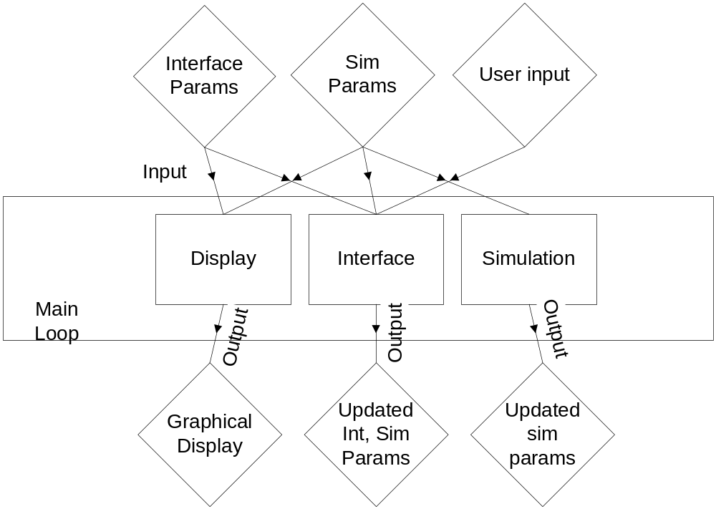
Main Engine Overview

Slide 6
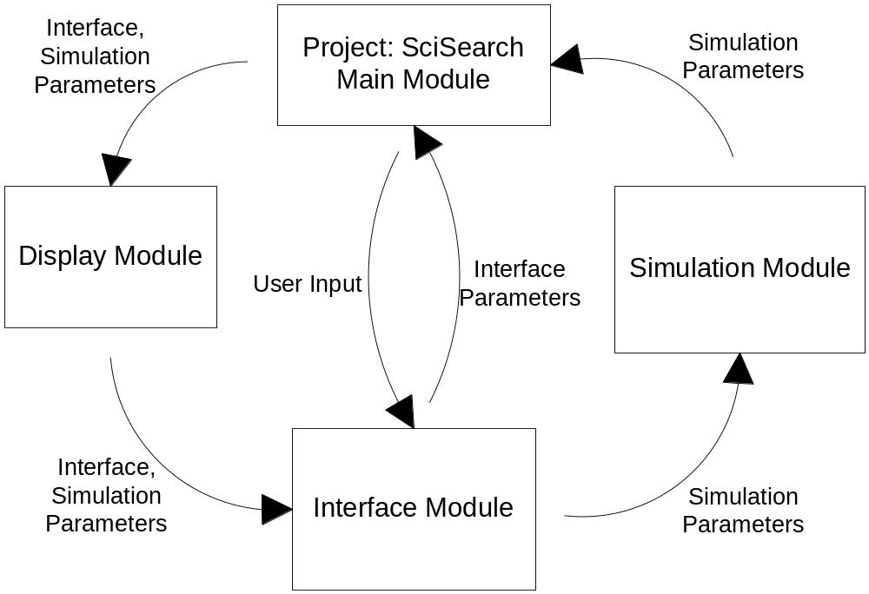
Data Flow

Slide 7
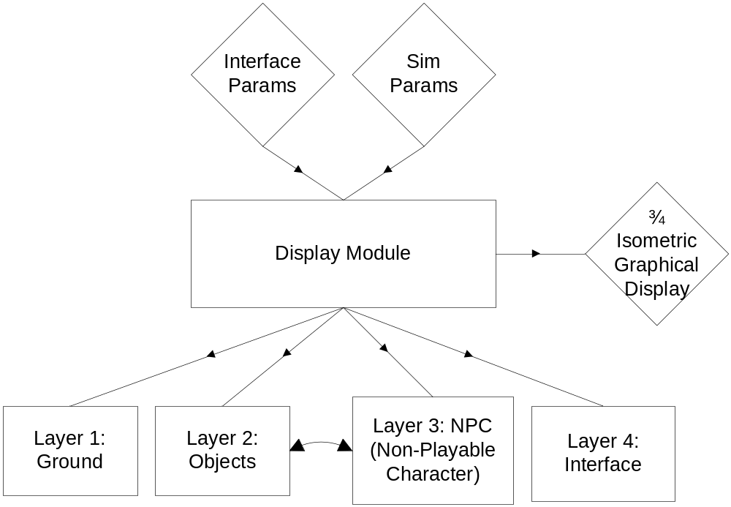
Display Module

Slide 8
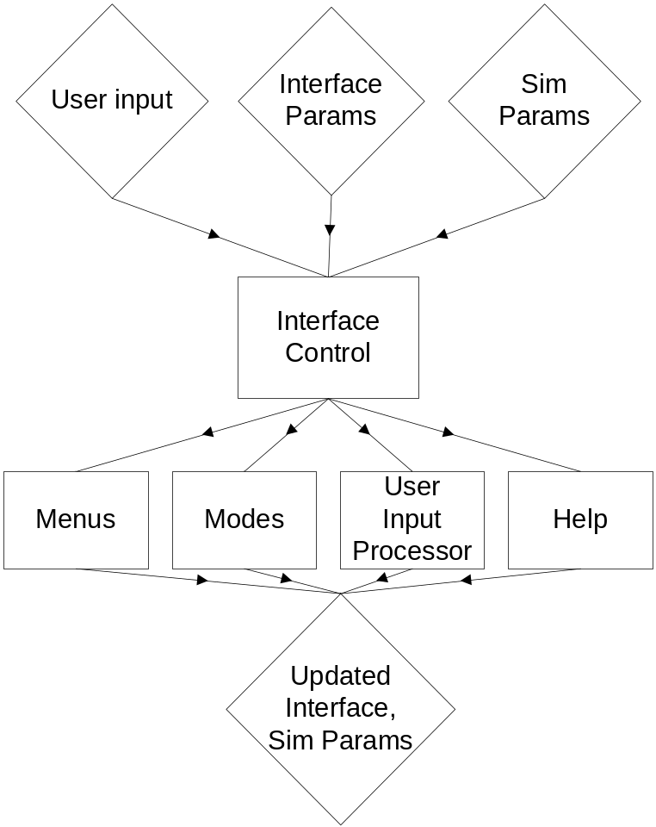
Interface Module

Slide 9
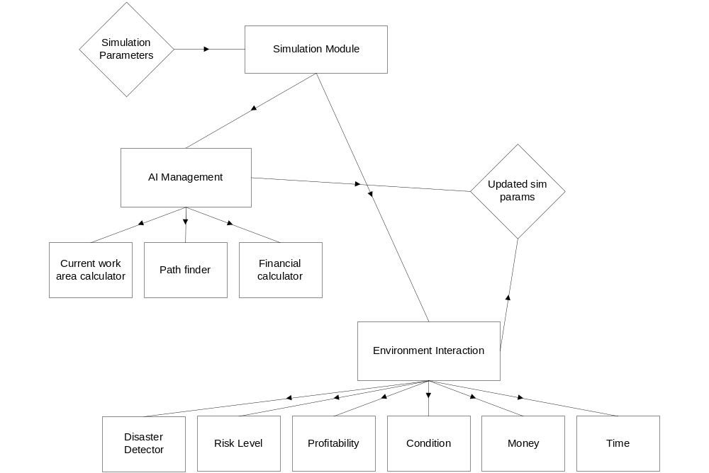
Simulation Module

Slide 10
Module List
Module Name | Module Function | Called By | Calls
Display | Graphical Output | Main Loop | Ground,Object,NPC,Interface
Ground | Draw Ground | Display | None
Object | Draw Objects | Display | None
NPC | Draw NPCs | Display | None
Interface | Draw Interface | Display | None
Interface | Handle Interface Updates | Main Loop | Menus,Modes,Help,Input
Menus | Handle Menu Structure | Input | None
Modes | Handle Modes | Input | None
Help | Handle Help System | Input | None
Input | Handle User Input | Interface | Menus,Modes,Help
Simulation | Handle sim events | Main Loop | Environ, AI
Environ | Handle Environ Cues | Simulation | None
AI | Handle AI responses | Simulation | None

Slide 11
Module List
Module Name | LOC Current | LOC left | Hrs current | Hrs left | % complete | Cost
Display | 2,000 | 0 | 47 | 0 | 100% | $3,000
Ground | 500 | 0 | 25 | 0 | 100% | $1,500
Objects | 700 | 0 | 8 | 0 | 100% | $500
NPCs | 300 | 0 | 5 | 0 | 100% | $500
Interface | 500 | 0 | 9 | 0 | 100% | $500
Interface | 2,000 | 0 | 32 | 0 | 100% | $3,300
Menus | 600 | 0 | 9 | 0 | 100% | $2,000
Modes | 600 | 0 | 8 | 0 | 100% | $400
Help | 200 | 0 | 5 | 0 | 100% | $300
Input | 600 | 0 | 10 | 0 | 100% | $600
Simulation | 1,000 | 0 | 32 | 0 | 100% | $3,700
Environ | 500 | 0 | 10 | 0 | 100% | $2,000
AI | 500 | 0 | 22 | 0 | 100% | $1,700
TOTAL | 5,000 | 0 | 111 | 0 | 100% | $10,000

Slide 12
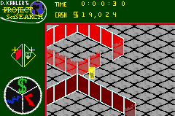
GUI Mockup

Slide 13
Verification Testing - Display
Test | Input/Action | Expected Output | Results/Comments
Depth sorting | Place new NPCs near (above/below) object walls | New NPCs depth rendering consistent with real-world | Passed.
Scroll updating | Press scroll buttons | Display scrolls in appropriate direction and renders | Passed.
Response time | Measure framerate in emulator | Framerate >= 10fps | Passed.
Screen clearing | Enter and exit help mode | Help graphics clear from background | Passed.
Sprite display | Sprite list for one frame in emulator | Matching sprite display on screen | Passed.

Slide 14
Verification Testing - Interface
Test | Input/Action | Expected Output | Results/Comments
L/R buttons 1 | Press L/R in main mode | Scrolling select through mode types | Passed.
L/R buttons 2 | Press L/R in sim mode | Scrolling through visible object selection | Passed.
B button | Press B button in any mode | Mode is exited if applicable | Passed.
A button 1 | Press A button in main mode | Selected mode is activated | Passed.
A button 2 | Press A button in obj creation mode | Selector appears/obj is created | Passed.
A button 3 | Press A button in obj deletion mode | Selected obj is deleted | Passed.
A button 4 | Press A button in npc creation mode | NPC is created at selected spot | Passed.
A button 5 | Press A button in npc deletion mode | Selected NPC is deleted. | Passed.

Slide 15
Verification Testing - Simulation
Test | Input/Action | Expected Output | Results/Comments
Env. Risk | Inspect Risk for NPCs | Equal to Risk eq. | Passed.
Env. Profit | Inspect Profit for obj | Equal to Profit eq. | Passed.
Env. Maintenance | Inspect Maint. for obj | Equal to Maint. eq. | Passed.
Env. Money | Inspect Money for sim | Equal to Money eq. | Passed.
Env. Time | Compare to real-world | Accurate to within 5sec/hr | Passed.
AI Disaster | Compare NPC disaster detector | Equal to DD eq. | Passed.
AI Current Work Area | Inspect WA Cycle | NPC follows timed cycle | Passed.
AI Path Finder | Inspect new path | Path conforms to iterative algorithm | Passed.
AI Money | Inspect AI salary | Salary subtracts from global money | Passed.
Sprite overload | Insert overload of Obj/NPC | System prevents crash by not overallocated sprites | Passed.

Slide 16
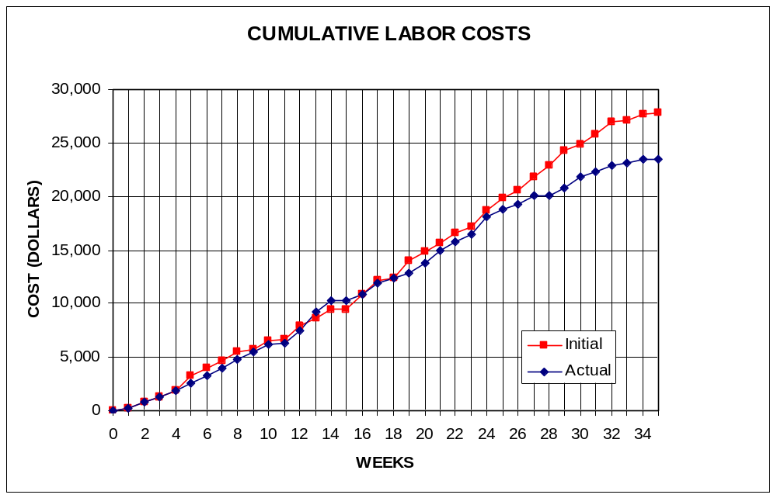
Labor Costs vs. Time

Slide 17
Economic Analysis - Prototype
PERSON | LABOR RATE | INITIAL EST. HRS. | INITIAL EST. COST | CURRENT EST. HRS. | CURRENT EST. COST
COMP. SYSTEMS ANALYST | $45.00 | 150 | $6,750 | 125 | $5,625
COMP. PROGRAMMER | $40.00 | 204 | $8,160 | 238 | $9,520
TEST PROGRAMMER | $35.00 | 104 | $3,640 | 74 | $2,590
TECHNICAL WRITER | $35.00 | 271 | $9,485 | 164 | $5,740
SUBTOTAL |  | 729 | $28,035 | 601 | $23,475
ENGINE @ 70% |  | 510 | $19,625 | 421 | $16,433
GAME @ 30% |  | 219 | $8,411 | 180 | $7,043
TOTAL |  | 729 | $28,035 | 601 | $23,475
DIRECT OVERHEAD @ 100% |  |  | $28,035 |  | $23,475
SUBTOTAL |  |  | $56,070 |  | $46,950
A & G COSTS @ 40% |  |  | $22,428 |  | $18,780
SUBTOTAL |  |  | $78,498 |  | $65,730
PROFIT @ 20% |  |  | $15,700 |  | $13,146
TOTAL COST OF PROTOTYPE |  |  | $94,198 |  | $78,876

Slide 18
Economic Analysis - Profits
COSTS | RATE | HOURS | INITIAL COST/COPY |  | CURRENT COST/COPY
CONSTRUCTION TIME | $20.00 | 0.25 | $0.50 |  | $0.50
SUBTOTAL DIRECT LABOR |  |  | $0.50 |  | $0.50
INDIRECT OVERHEAD @ 100% |  |  | $0.50 |  | $0.50
SUBTOTAL |  |  | $1.00 |  | $1.00
DOCUMENTATION |  |  | $2.00 |  | $2.00
PACKAGING |  |  | $3.00 |  | $3.00
SUBTOTAL |  |  | $6.00 |  | $6.00
A & G @ 40% |  |  | $2.40 |  | $2.40
SUBTOTAL |  |  | $8.40 |  | $8.40
PROFIT @ 20% |  |  | $1.68 |  | $1.68
SUBTOTAL |  |  | $10.08 |  | $10.08

Slide 19
Economic Analysis – Profits
RECOUP COST OF PROTOTYPE | COSTS | UNITS TO
 |  | SELL
INITIAL | $94,198 | 100,000 | $4.71
CURRENT | $78,876 | 100,000 |  |  | $3.94
RECOUP OVER |  | 20,000
MANUFACTURING COSTS |  |  | $14.79 |  | $14.02
WHOLESALE MARKUP @ 20% |  |  | $2.96 |  | $2.80
SUBTOTAL |  |  | $17.75 |  | $16.83
RETAIL MARKUP @ 50% |  |  | $8.87 |  | $8.41
TOTAL RETAIL COST |  |  | $26.62 |  | $25.24
PROFIT (ON FIRST 20,000) |  |  | $33,600 |  | $33,600
PROFIT (ON THE REST) |  |  | $292,708 |  | $271,331
TOTAL PROFIT |  |  | $326,308 |  | $304,931

Slide 20
Project: SciSearch
Final Demonstration

